Slide 1
Defibrillator for Use Through a Right Minithoracotomy
Team 25:
Stephen Browning
Kathleen Kafka (presenting)
Kelly Moor
Mentors:
Dr. Damiano
Dr. Robertson
Dr. Okada
Dr. Saint

Slide 2
Overview
Overview Analysis Design Materials/Manufacturing Conclusions
Scope:
Minimize dangerous patient convulsions caused by shock
Successful and safe defibrillation
Right minithoracotomy
LIFEPAK 20e compatibility
Our Design:
Prototype design
SVC coil electrode
RV epicardial patch electrode
Connecting cables
Notes:
Need and/or specific design requirements; quick overview of chosen design concept

Slide 3
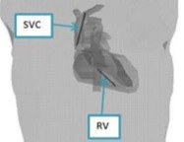
Electrode Configuration
Overview Analysis Design Materials/Manufacturing Conclusions
Literature search
Similar electrode configurations
DFT: 10-20 J
Damiano lab meeting
Electrode placement is doable
References
De Jongh et al.
Finite element analysis
Clinical trials
Kinst et al.
Finite element analysis
Winkle et al.
SVC coil electrode
LV apex patch electrode
Notes:
Specific Details of Analytic Efforts needed for design (15 pts.) (calculations for power requirements, weight, sampling speeds, BW, etc.)

Slide 4
Electrodes: Literature, Patents, Surgeon Interviews
Overview Analysis Design Materials/Manufacturing Conclusions
Transvenous SVC Coil
Surface area: 1200 mm²
Range from similar ICD electrodes: 160-860 mm²
Larger surface area → lower DFT
Coil length: 6 cm
Shorter → easier to maneuver
Diameter: 2.83 mm (8.5 French)
Must fit through central line
Size limit: 8.5 French
Placement: SVC
Commonly used ICD site
RV Epicardial Patch
Surface area: 16.2 cm²
Range found in literature: 12-33 cm²
Larger surface area → lower DFT
Length: 5.5 cm
Rudski et al. – small RV length = 5.6 cm
Fits on most RVs
Width: 3.5 cm
Fits through 4 cm diameter incision
Placement: between diaphragm and RV
Not a common site
Used in a few case studies – Yoda et al. & Molina et al.
Recommended by Dr. Damiano

Slide 5
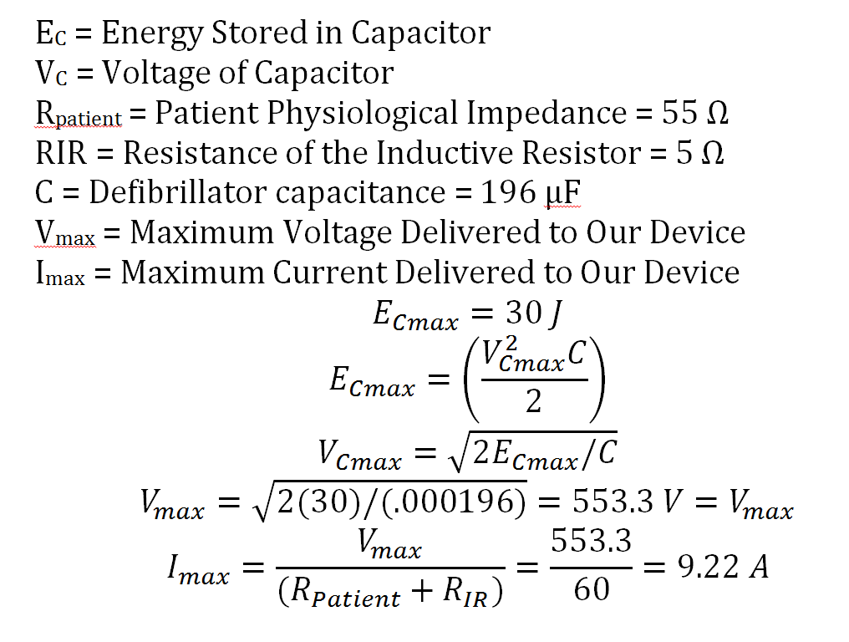
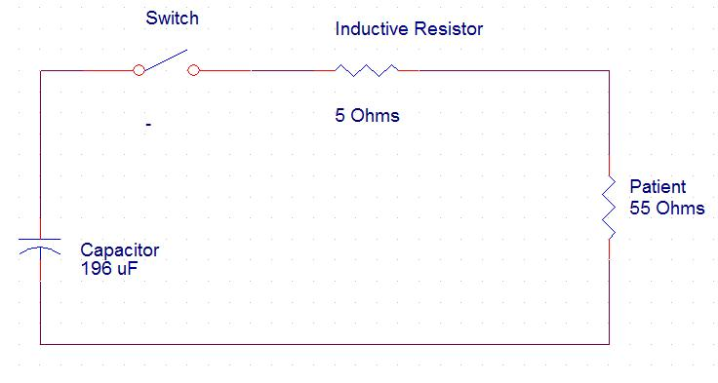
LIFEPAK Circuit Analysis
Overview Analysis Design Materials/Manufacturing Conclusions
Note: this calculation assumes a DFT of 30 J, but we expect a lower DFT of 20 J for our design
Current range reported by Kinst et al.: 6.4 – 11.9 A
Voltage reported by Kinst et al.: 615 V

Slide 6
SVC Electrode
Overview Analysis Design Materials/Manufacturing Conclusions
Inserted through the right internal jugular vein
Pre-existing central line port
Placed in the SVC
Can be checked for correct placement by feeling the SVC
Trifilar coil
More surface area
Flexibilty
Redundancy

Slide 7
Overview Analysis Design Materials/Manufacturing Conclusions
(all units are in mm)
(with break)
connector

Slide 8
RV Epicardial Electrode
Overview Analysis Design Materials/Manufacturing Conclusions
Inserted through the right minithoracotomy incision
Placed on the inferior RV wall
Held in place by the diaphragm
Visual check for correct positioning
Mesh
More surface area
Semi-rigid
No longer under patent protection
Notes:
Specific Details of Chosen Design (15 pts.) (drawings, required parts, software overviews, safety, wiring and circuit diagrams, etc.)

Slide 9
Overview Analysis Design Materials/Manufacturing Conclusions

Slide 10
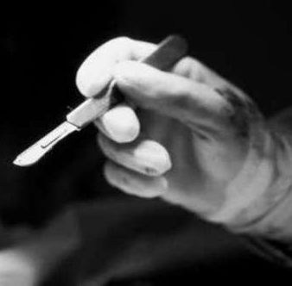
Safety – Risk Reduction
Overview Analysis Design Materials/Manufacturing Conclusions
Electrode design – silicone “padding”
Eliminates sharp edges
Training
Extensions of pre-existing training
Warnings
Sharp edges and electrical danger
High impedance indicates incorrect placement
Manuals
Set up and use of electrode
Ignitable oxygen
Gloves and protective clothing
Hazardous biological waste
Blood borne illness

Slide 11
Materials, Cost, and Lead Times
Overview Analysis Design Materials/Manufacturing Conclusions
Part | Description | Material | Manufacturer | Cost | Lead Time
SVC Electrode | Conductor Coil | Tantalum coated copper | McMaster Carr | $95 | 1 week
Epicardial Electrode | Conductor Mesh (1/2 ft²) | Titanium mesh (50 lines/inch) | Unique Wire Weaving Company | $120 | 2-3 days
Epicardial Electrode | Insulator Backing | Silicone sheeting | Bioplexus | $150 | 1 week
Connector Cable | Wire (100 ft) | Silicone coated copper wire | Alpha Wire | $560 | 1-2 days
Connector Cable | Polyurethane coating (36 yards) | Polyurethane tape | 3M | $1,300 | 10-15 days
Connectors | 3 connectors | polyester | Molex | $3 | 1-2 days
Total for prototype production = $2200
Notes:
Specific Material and Manufacturing definitions (15 pts.) (part prices and lead times, overview of manufacturing processes, etc.)

Slide 12
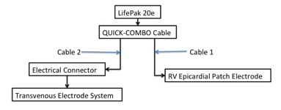
Prototype Production
Overview Analysis Design Materials/Manufacturing Conclusions
Transvenous SVC Electrode
Strip section of silicone coated 3-conductor wire
Coil wire to defined length and diameter
Electroplate with tantalum
Attach silicone tip
Attach to cable using Molex connector
RV Epicardial Electrode
Cut silicone and titanium mesh to size
Stretch silicone over mesh
Insert Molex connector between silicone and mesh
Cure in oven (25 min @ 350 degrees F)
Crimp to cable using Molex connector

Slide 13
Intellectual Property
Overview Analysis Design Materials/Manufacturing Conclusions
Several design aspects taken from patents
Transvenous Electrode: Intermedics, Inc. Patent
Epicardial Electrode: Ideker Patent
Expired patent protection
Later patents
Specific uses
Attachment methods (ICD)
No patent infringement
Our IP
Utility patent
Temporary implantation
Minithoracotomy
Notes:
Conclusions (10 pts.) (Did you solve the problem?, Future directions?, What did you learn? What would you do different?, Is there any IP in your Project? What? Why is it IP?)

Slide 14
Discussion
Overview Analysis Design Materials/Manufacturing Conclusions
What did we learn?
Surgeons vs. engineers
Mechanical drawing tools
Design process
Future Directions
Application to partial sternotomy and left minithoracotomy
Patch electrode applicator
FDA Approval: Animal/Human Trials
Optimal materials – cost versus efficacy
Optimal placement – lower DFT
Adjustment to electrode size and shape
What would we have changed?
More discussion with Dr. Damiano
Engineering mentor
Problem Solved?
Direct conduction into myocardium
Lower energy
Less skeletal muscle activation
Minimizes patient movement caused by shock
Patient Safety
No extra incisions
Fits through minithoracotomy
Notes:
What we learned

Slide 15
Questions?

Slide 16
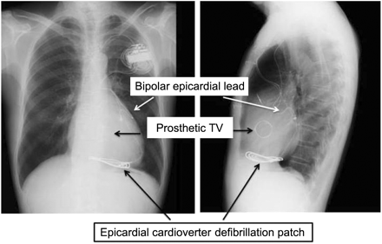
Overview Analysis Design Materials/Manufacturing Conclusions

