Slide 1
A Safer Defibrillator for Minimally Invasive Cardiac Surgery
Preliminary Oral Report
By Stephen Browning
Team Members: Kathleen Kafka and Kelly Moor

Slide 2
Defibrillation Background
Fibrillation
Uncoordinated and unpredictable contraction of the myocardium
Understood Causes
Re-entry [2]
Hyperautomaticity [1]
Defibrillation
Clinically: Fully stimulate myocardium ➔ refractory periods stop fibrillation ➔ sinus rhythm continues
Four Theories: Critical mass, Upper Limit of Vulnerability, Progressive Depolarization, and Virtual Electrode [3]

Slide 3
Defibrillation Background (cont.)
Defibrillation Efficacy [3]
Defibrillation Threshold (DFT) Algorithms
Step-Down failure (70%)
Step-Up success (30%)
Iterative increment-decrement (50%)
Clinically
Patient specific DFT unattainable
Risk factors indicate elevated DFT [3]
Must add safety factor

Slide 4
Defibrillation Techniques
Biphasic Waveform
Current industry standard
More effective than monophasic [3]
Energy Requirement
External (~200-400 J) [4]
Between Scapulae – Over Cardiac Apex
Left Axillary – Right pectoral
Internal (~10-40 J) [3]
Endocardial
RV apex and RA median wall
Epicardical
Trans-ventricular

Slide 5
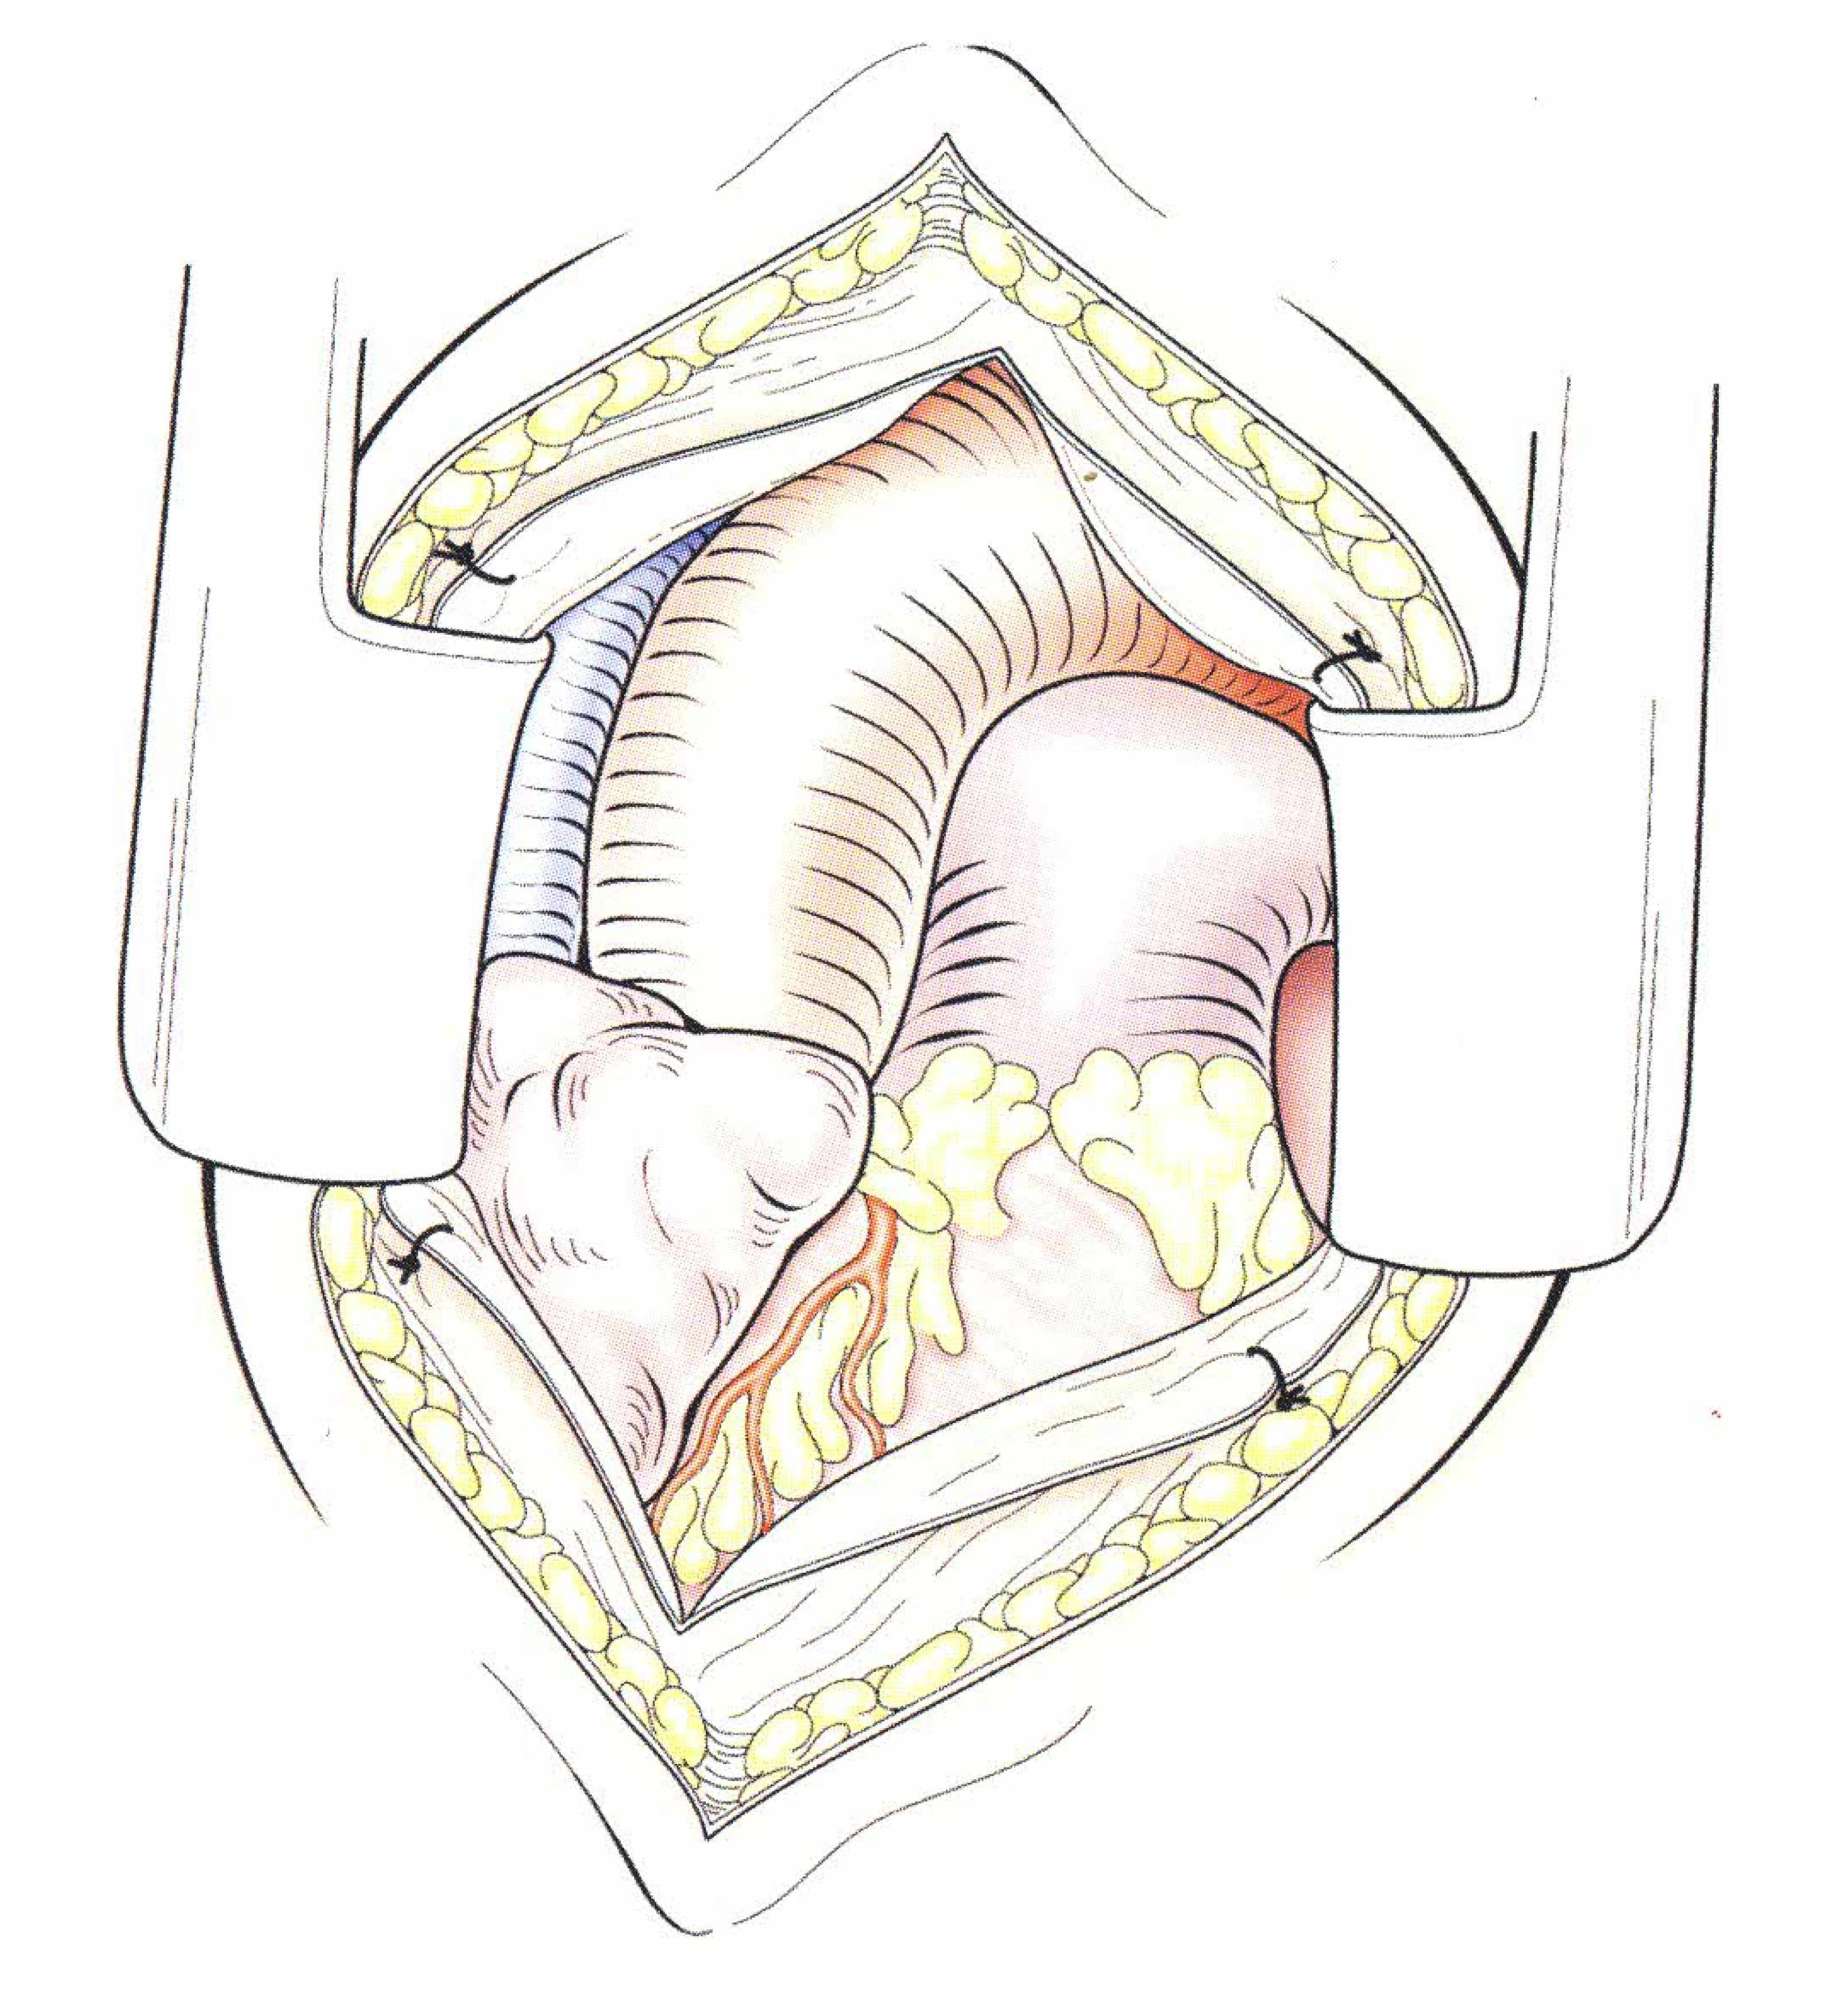
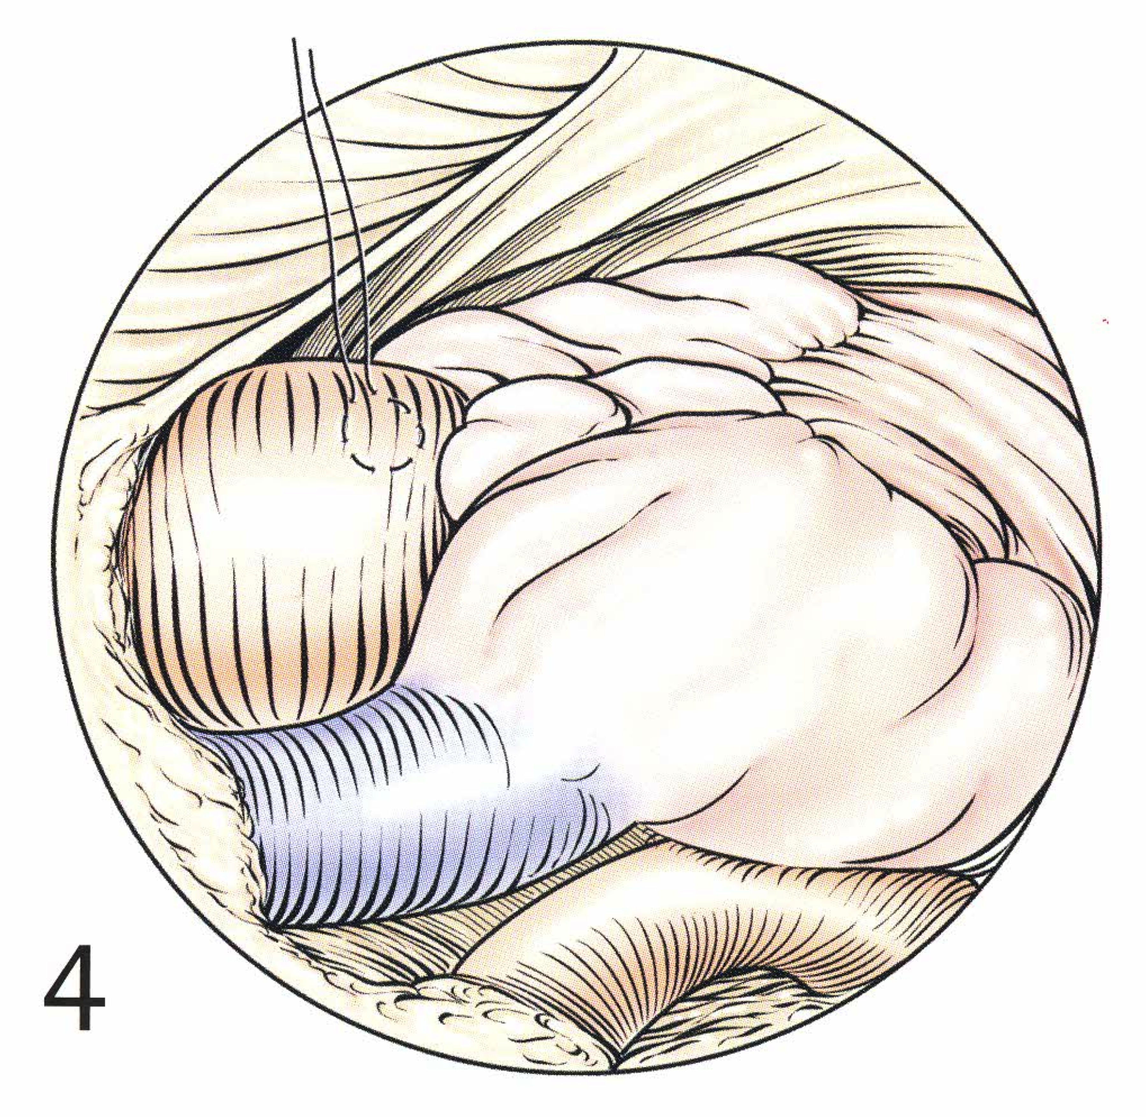
Surgical Background Picture Citation [9]
Mini Sternotomy
Right Mini-Thoracotomy
8-10 cm incision in upper sternum
Excellent visualization of aorta and right atrium
4-6 cm incision in 4th intercostal space
Excellent right atrium visualization
Aortas
Right Atria

Slide 6
The Problem
Surgeons can encounter fibrillation events at most stages of a heart surgery
Minimally invasive surgeries use external pads to deliver defibrillation shocks
Problem with this solution
Energy required ~200-400J
Skeletal muscle contraction
Skin burns
Must move to internal defibrillation
Allows for the use of much lower energies (~10-40 J)

Slide 7
Project Scope
Devise a safer method for cardiac defibrillation during a surgical procedure through a mini-sternotomy or a right mini-thoracotomy
Deliverables
Surgical Protocol
CAD drawings of all mechanical components
Circuit diagrams for all electrical components
Material Analysis
Manufacturing Analysis
Computational design analysis
Cost Analysis

Slide 8
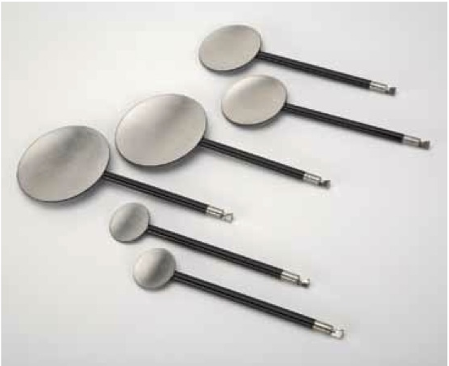
Existing Solutions and Problems Picture Citation [10]
Too Rigid
Internal Defibrillator
operable with one hand (7706876)
Current PhysioControl Internal
Adult Paddles (PhysioControl)
Unavailable Access Method
Internally deployable defibrillator (4567900)
Methodes of surgically implanting a defibrillator electrode (5618287)
Permanently Implanted
Lead fixation means (8019437)

Slide 9
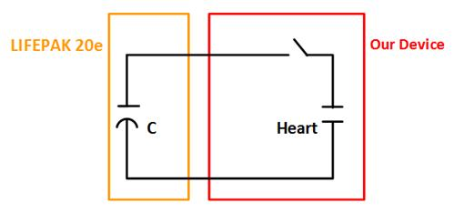
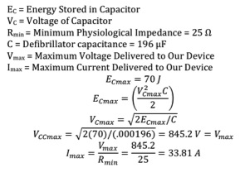
Preliminary Electrical Analysis

Slide 10
Design Requirements
Must be compatible with PhysioControl LIFEPAK 20e Defibrillator unit
The Device must support all energy settings up to 70 J
The Device must support 845 V and 33 A
Connection between electrodes and defibrillator unit must be 2.5-3 m
Electrodes must fit through smallest mini-thoracotomy incision (largest dimension <4cm)
Electrodes must safely navigate anatomical barriers to placement sites
Electrodes must not damage cardiac tissue

Slide 11
Design Requirements (cont.)
Shock shall be deliverable no more than 20 seconds after recognition of a fibrillation event [5] [6]
Must withstand sterilization from one of the following [7]
Steam autoclave, ethylene oxide, Sterrad, Steris System 1, or gamma sterilization
Deployment Specific
Leave-In
Wires should be easily maneuverable and occupy only 1% of the surgical opening
Rapidly Deployable
Safely deployable in the defined time metric
Must be safe for all physicians and OR staff

Slide 12
Organization of Responsibility
Kathleen
Design: Mechanical Engineering problems
Research: Defibrillation Techniques
Kelly
Design: Computer Science/Signal Processing problems
Research: Surgical Procedures
Stephen
Design: Electrical Engineering problems
Research: Current Technologies/Patents

Slide 13
Design Schedule
October 3- Group brainstorm for design ideas
October 5- Webpage due
October 9- Finalize design ideas
October 13- Complete analysis to choose a design
October 16- Complete required analysis on chosen design
October 23- Finish rough draft of progress report
October 26- Progress Report due
November 3- Complete specific details of chosen design
November 10- Finalize details of analytic efforts needed for design
November 17- Determine manufacturer of device
November 20- Perform cost analysis for device
November 30- Complete rough draft of final report
December 7- Final Report due

Slide 14
References
Dubin, Dale. Rapid Interpretation of EKG’s. Cover Inc. 2000.
Iaizzo, Paul A. Handbook of Cardiac Anatomy, Physiology, and Devices. Springer Science LLC. 2009.
Friedman, Paul A. and Hayes, David L. Cardiac Pacing, Defibrillation, and resynchronization: A Clinical Approach. Wiley-Blackwell. 2008
Bojar, Robert M. et.al. Use of Self-Adhesive External Defibrillator Pads for Complex Cardiac Surgical Procedures. Annals of Thoracic Surgery. 1988; 46:586-588.
Windecker, Stephan et.al. The Influence of Ventricular Fibrillation Duration on Defibrillation Efficacy Using Biphasic Waveforms in Humans. 1999.
Bardy, Gust H. et.al. A prospective, randomized evaluation of effect of ventricular fibrillation duration on defibrillation threshold in humans. 1988.
LEMO USA. Medical Sterilization Methods. http://www.lemo.com/download/imagesprod/P_series_whitepaper.pdf.
Resuscitation Central. Understanding Defibrillation Waveforms. http://www.resuscitationcentral.com/defibrillation/biphasic-waveform/.
Gardner, Timothy J. and Spray, Thomas L. Operative Cardiac Surgery. Oxford Press. 2004.
PhysioControl. LIFEPAK 20 Accessories. http://www.physio-control.com/uploadedFiles/products/defibrillators/product_data/accessories/LP20-20e_Accessories_3301326_A.pdf.

Slide 15
Questions?

