Slide 1
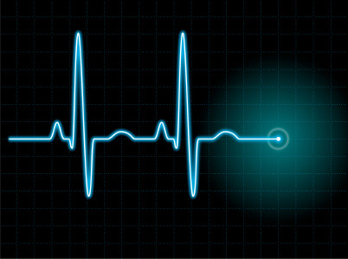
Defibrillator For Use in Minimally Invasive Surgery
Kelly Moor
Kathleen Kafka
Stephen Browning

Slide 2
Demonstrated Need
Dramatic increase in popularity of minimally invasive surgical procedures
Smaller incision size disallows for traditional use of internal paddles to defibrillate patient
External paddles only current technology compatible with minimally invasive surgery
Result in dangerous convulsion by patient when shocked
Indicates need for redesign of defibrillation electrodes and leads to be more compatible with minimally invasive surgery

Slide 3
Design Specifications
Internal components must fit through 4cm diameter incision size
Maximum of 20 sec should pass between fibrillation recognition and stimulus delivery
Leads must be compatible with LIFEPAK 20e defibrillator unit
Leads must cause no unintended damage to myocardium or other internal tissues
Components in contact with bodily tissue must be made of hypoallergenic material
Reusable components must be sterilizable by ethylene oxide

Slide 4
Design Alternatives
KCl injection
Injection of KCl into the heart
KCl would arrest the heart by preventing action potentials from firing
Successfully stop fibrillation, but cardiac massage often needed to restart the heart

Slide 5
Electrode Types
Internal Patch
Manually Placed
Endocardial Lead
Left Pectoral Internal
External Patch
Abdominal Internal

Slide 6
Internal Patch Electrodes
Electrode enclosed in flat, round, insulated patch
Placement on either left or right ventricle
Held in place by superficial sutures placed in myocardium
Left in place throughout surgery

Slide 7
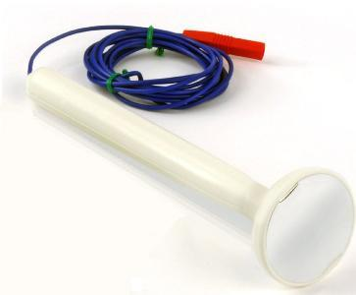
Manually Placed Electrodes
Right or left ventricular
Direct contact with ventricular epicardium
Conductive electrode attached to ergonomic, electrically insulated handle
Only applied during defibrillation
Manually held in place by surgeon during defibrillation

Slide 8
Endocardial Electrodes
Insulated lead with electrode placed at right or left ventricular apex
Solves problem of difficult access locations by feeding lead through accessible locations of heart
Leads would enter through existing ports to prevent extra incisions
Cardioplegia cannula
Swan-Ganz catheter

Slide 9
Endocardial Electrodes

Slide 10
Left Pectoral Internal Electrodes
Subcutaneous
Inserted through additional incision
Held in place by a single suture and encapsulation by tissue
Thoracic cavity
Inserted through main surgical incision
Sutured to internal chest wall

Slide 11
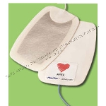
External Patch Electrode
Typical external patch placed in contact with skin
Location chosen to maximize myocardial mass between electrodes
Lower energy could be used if paired with an internal electrode
davismedical.com

Slide 12
Abdominal Internal Electrode
Paired with two internal electrodes to reproduce common ICD configuration
Inserted through main incision site
Held in place by sutures

Slide 13
List of Design Alternatives
Left Pectoral Internal Electrode + RV Patch Electrode
Left Pectoral External Patch Electrode + RV Patch Electrode
LV Patch Electrode + Right Pectoral External Electrode
LV and RV Patch Electrodes
Manually Placed LV + RV Patch Electrodes
LV Patch Electrode + Manually Placed RV Electrode
RV Patch Electrode + Manually Placed LV Electrode
Left Pectoral Internal + RV Manual Electrode
Abdominal Electrode + Two Internal Electrodes
LV Endocardial Lead + RV Patch
LV Endocardial Lead + Manually Placed RV Electrode
LV Endocardial Lead + External Patch
LV Patch + RV Endocardial Lead
Manually Placed LV Electrode + RV Endocardial Electrode
RV Endocardial Lead + Internal Left Pectoral Electrode
RV Endocardial Lead + External Patch
External Electrode + LV Manual Electrode
External Electrode + RV Manual Electrode
KCL Injection

Slide 14
Analysis of Design Alternatives
Minimize Defibrillation Energy
Assigned values based data found in literature based on clinical studies and electrode placement modeling
Minimize Added Risk to Patient
Assigned risk values based on whether leads required blind navigation for placement, potentially resulting in perforation of the myocardium or coronary arteries
Ease of Electrode Placement
Values based on need for blind placement, additional procedures, or sutures for attachment
Surgeon Preference
Values assigned based on interviews with surgeons and how they believed designs would be received by fellow surgeons
Minimize Additional Procedure Time
Assigned values based on the amount of time our device would add to the procedure

Slide 15
Reduce Fibrillation Duration
Values assigned based on how quickly the shock could be delivered.
Example: Manual placement vs. electrodes left in place throughout procedure
Maximize Myocardial Mass Between Electrodes
Studies show maximizing mass between electrodes increases probability of successful defibrillation
Values assigned based on ventricular mass between electrodes
Patient Aesthetics
Assigned values based on need for extra incisions or probability of causing burns on the skin
Cost
Values based on comparison to similar electrodes on the market
Post-Operative Patient Discomfort
Points detracted for designs requiring additional incisions or burn marks on the skin
Achievable before Deadline
Assigned values based on expected amount of redesign of existing devices

Slide 16
Pugh Chart
Design Criteria | Weight | Manual RV - Left Thoracic Cavity | RV Patch - Left Thoracic Cavity | Manual RV - Left Chest External Patch | Manual RV - External Back Patch | RV Patch - Left Chest External Patch | RV Patch - Back External Patch | LV Patch - Manual RV | LV Patch - RV Patch
Cost | 3 | 6 | 6 | 7 | 7 | 7 | 7 | 6 | 6
Due Date | 1 | 6 | 8 | 8 | 8 | 10 | 10 | 8 | 10
Added Surgical Time for Extra Procedure | 6 | 6 | 5 | 9 | 9 | 8 | 8 | 4 | 3
Ease of Electrode Placement | 8 | 8 | 8 | 9 | 9 | 9 | 9 | 6 | 6
Surgeon Preference | 7 | 10 | 10 | 10 | 10 | 10 | 10 | 10 | 10
Minimize Added Risk to Patient | 10 | 7 | 6 | 9 | 9 | 8 | 8 | 5 | 4
Reduce Fibrillation Duration | 5 | 9 | 10 | 9 | 9 | 10 | 10 | 9 | 10
Patient Aesthetics | 4 | 10 | 10 | 8 | 8 | 8 | 8 | 10 | 10
Minimized Delivered Energy for Defibrillation | 10 | 10 | 10 | 3 | 3 | 3 | 3 | 10 | 10
Maximizes Myocardial Mass between electrodes | 5 | 10 | 10 | 10 | 10 | 10 | 10 | 10 | 10
Minimize Post-Op Patient Discomfort | 1 | 10 | 10 | 6 | 6 | 6 | 6 | 10 | 10
TOTALS |  | 509 | 500 | 478 | 478 | 469 | 469 | 463 | 454

Slide 17
RV Manual Electrode + Left Thoracic Cavity Electrode
RV Manual Electrode
Right ventricle easily accessible through main incision
Electrode manually positioned by surgeon using insulated handle
Left Thoracic Cavity Electrode
Internal chest wall visible through main incision
Insulated, inflatable shell sutured onto internal chest wall
Electrode attached to opposite end moved into contact with left ventricle upon inflation of shell

Slide 18
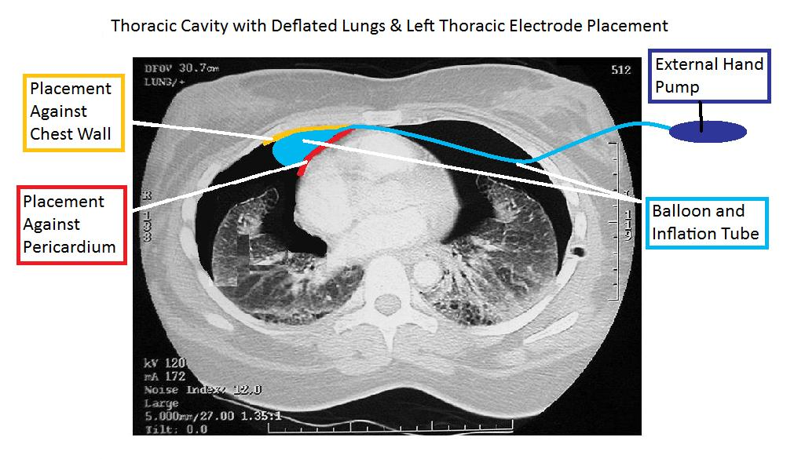
Details of Design
Capacitor
Inductor
H-Bridge
QUICK-COMBO Therapy Cable
Our Accessory
Patient

Slide 19
Design Schedule
November 1 – Present design idea to Dr. Damiano
November 3 – Complete specific details of chosen design
November 10 – Finalize analysis needed for design
November 17 – Determine manufacturers of device materials
November 20 – Perform cost analysis for device
November 30 – Complete rough draft of final report
December 7 – Final report due

Slide 20
Team Responsibilities
Stephen Browning
Research of patents and current technology
Development of circuit models
Development of mathematical models for defibrillation
Kathleen Kafka
Research of defibrillation techniques
DesignSafe
Update group website
Weekly reports
Kelly Moor
Research of surgical techniques
Computer models of electrical systems
CAD drawings

Slide 21
Questions?

